Slide 1

Department of Computer Engineering
Personalised Product Recommendation System using Hybrid Approach Based on Content Based and Collaborative filtering.
Group Number: 54
Presented By :
Patil Amit A.
Kothari Shubham V.
Kove Ajinkya M.
Salwade Shweta M.
Motgi Prem P.
Guided By: Prof. C. A. Laulkar

Slide 2
Content
Problem Statement
Project Scope
Functional Requirements
Non-Functional Requirements
System Architecture
Literature Survey
Modules:-
2.1. Security and Authentication
2.2. QR Code Generator and Decryptor
2.3. History & User Data
2.4. Recommendation Engine
2.5. Result Optimization & Generation
Dataset Description
Hardware and Software Requirements

Slide 3
Content
Mathematical Model
UML Diagrams
Test Cases Documents
Results
Conclusion
References

Slide 4
Problem Statement
Design a Personalised Product Recommendation System using Hybrid Approach Based on Content Based and Collaborative filtering.

Slide 5

Motivation
To increase customer satisfaction and to improve economic success of shopping complexes.
Daily hurdles while shopping.
Leaving customers with eclectic choice.
Eradicating necessity of large amount of data.

Slide 6
Idea Matrix
Idea matrix

Slide 7
Literature Survey
Literature Survey

Slide 8
Architecture Diagram

Slide 9
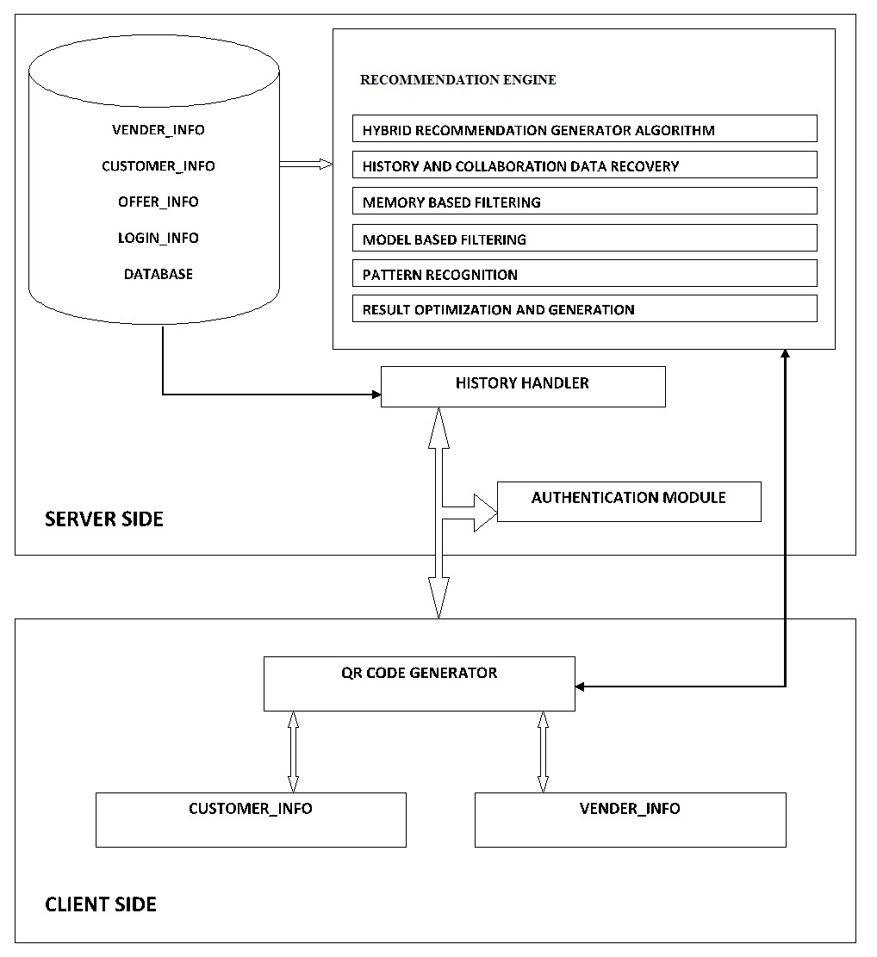

Slide 10
Modules
Security And Authentication
QR Code Generator and Decryptor
History And User Data Management
Recommendation Engine
Result Optimization & Generation

Slide 11
Security & Authentication
Client-Server Architecture
Avoid unauthorized access
Numbers are assigned according to the user roles.
QR Code as identification

Slide 12
Authentication algorithm
Broadcasting of MAC-address over the Network (Broadcast to locate servers).
Message exchange ( Hand-shaking protocol )
Request from the source
Reply from destination
After request from source, Every other device examines the request.
Device whose MAC in the request, unicast the response to source.

Slide 13
QR Code Generator & Decryptor
Unique Identification
Need
Device Independent

Slide 14
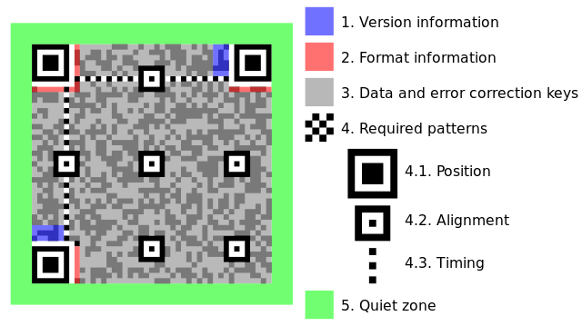
Structure of QR Code
Functional Region
Encoding Region
Quiet Zone

Slide 15
QR Code Generation & Decryption
Encoding of QR Code
Gray Scale Conversion
Binarization
Location and Orientation
Decoding

Slide 16
QR Code Generation Algorithm
Input Data is Encoded into Bit-Stream
Divided into codewords
Add the error-correction code word to the blocks.
Convert the information into matrix.
Function Patterns are added.

Slide 17
QR Code Decryption Algorithm
RGB image -> Gray Scale and Gray scale -> Binary.
Invert the image.
Locate the alignment pattern.
Calculate the gradient of tilt.
Tilt correction
Transformation Matrix: [cos A sin A, sin A -cos A].

Slide 18
Housekeeping & User Data
Data Confidentiality
Feeding Appropriate Data For Proper Recommendations
Maintain Information About Session
Monitoring the System.

Slide 19
Housekeeping & User Data
Case study for Amazon System
Introduction: Uses Content based recommendation Engine
Key Problems: Previous recommendations are not considered to generate new recommendations
Alternatives: Collaborative filtering and active feedback loop expert system must be used

Slide 20
Housekeeping & User Data
Background:
ACID properties.
Data is sorted and structurized.
History is maintained.
For Non logged In users separate non-personalized recommendations are shown.

Slide 21
Recommendation Engine
Based on Hybrid Approach:
•Content Based Filtering
•Collaborative Filtering
Performs on limited but Multi-Criteria Based Approach

Slide 22
Recommendation Algorithm
Input: User Profile Information
De-modularize Information.
Check common Objects among various Users.(CB)
Check common Users among various Object.(Col.)
Group similar Objects.
Create multiple recommendation Pool.
Sort Recommendations according to Criteria
Filter most precise recommendation by evaluating the result pool.

Slide 23
Recommendation Algorithm
Generate the result.
Result optimization
Output: Accurate Recommendations

Slide 24
Result Optimization & Generation
Collective Intelligence to Filter Best Choice
Conversion
Maintain the Flow

Slide 25
Dataset Characteristics
Amazon Metadata(Size, Date, Records, Type….)
Contents of Dataset
ID: Product id (0 to 548551)
ASIN: Amazon standard Identification Number
Title: Name/ Title of the product
Group: Product group (Book, DVD, Video etc)
Sale Rank: Amazon Sale rank
Categories: Hierarchy to which product belongs
Reviews: Product review info., time, uid, rating, total no. of votes.

Slide 26
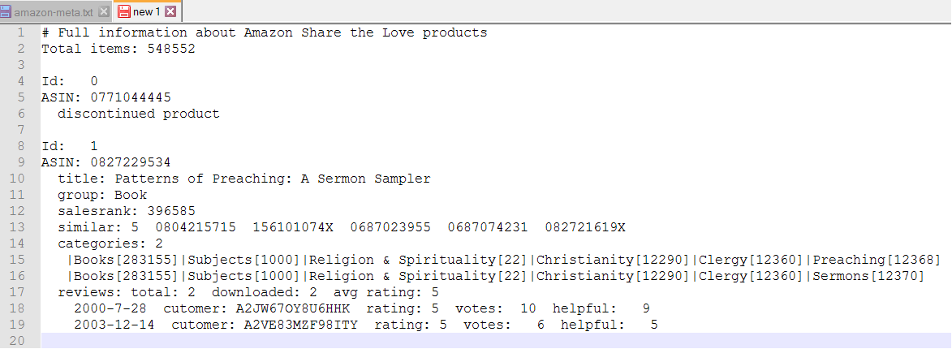
Dataset Characteristics

Slide 27
UML Diagrams
Class Diagram
ER Diagram
Use Case Diagram
State-Transition Diagram
Deployment Diagram

Slide 28
Mathematical Model
Recommendation Engine Module
QR-Code Module
Security and Authentication Module
Housekeeping Module

Slide 29
Hardware & Software Req.
Hardware:
RAM: 8 Gb
Storage: 10 Tb+
Processor: i5+
Router and Antenna
Operating System:
Server Side: Windows 7+
Vendor Side: Windows 7+/ Android 4.4+
Client Side: Android 4.4+
Browser: Mozilla 40.0 + / Internet Explorer 8+
SQL Server

Slide 30
References
[1] Yoon Ho Choa, Jae Kyeong Kimb, “A personalized recommender system based on web usage mining and decision tree induction” Expert Systems with Applications 23 (2002) 329–342.
[2] Keunho Choi a, Donghee Yoo b, Gunwoo Kim c,⇑, Yongmoo Suh, “A hybrid online-product recommendation system: Combining implicit rating-based collaborative filtering and sequential pattern analysis”, Electronic Commerce Research and Applications.
[3] Carlos A. Gomez-Uribe and Neil Hunt, “The Netflix Recommender System: Algorithms, Business Value, and Innovation”, ACM Transactions on Management Information Systems, Vol. 6, No. 4, Article 13, December 15.
[4] Li Bian, Henry Holtzman, “Online Friend Recommendation through Personality Matching and Collaborative Filtering ”, The Fifth International Conference on Mobile Ubiquitous Computing, Systems, Services and Technologies, 2011
[5] Jianfeng Hu, Bo Zhang, Product Recommendation System, CS224W Project Report, December, 2012
[6] Lina Yao, Quan Z. Sheng, “Unified Collaborative and Content-Based Web Service Recommendation” IEEE TRANSACTIONS ON SERVICES COMPUTING, VOL. X, NO. X, AUGUST 2014
[7] Joseph A. Calandrino, Ann Kilzer, Arvind Narayanan, ““You Might Also Like:” Privacy Risks of Collaborative Filtering”, 2011 IEEE Symposium on Security and Privacy

Slide 31
References
[8] Jun Wang, Arjen P. de Vries, “Unifying Userbased and Itembased Collaborative Filtering Approaches by Similarity Fusion”, 2006 ACM 1595933697/06/0008
[9] Hannon, John; Bennett, Mike; Smyth, Barry, Recommending twitter users to follow using content and collaborative filtering approaches”, 4th ACM Conference on Recommender Systems (RecSys 2010), Barcelona, Spain, September 26-30,2010
[10] Yehuda Koren,Robert Bell and Chris Volinsky, Matrix Factorization Techniques For Recommender Systems,
[11] Zhexue Huang, “A Fast Clustering Algorithm to Cluster Very Large Categorical Data Sets in Data Mining” Cooperative Research Centre for Advanced Computational Systems CSIRO.
[12] Wei-Sheng Chin, Bo-Wen Yuan, Meng-Yuan Yang, Yong Zhuang, Yu-Chin Juan, and Chih-Jen Lin., “LIBMF: A Library for Parallel Matrix Factorization in Shared Memory Systems”, Journal of Machine Learning Research.
[13] Yue Liu,Mingjun Liu, “Automatic Recognition Algorithm of Quick Response Code Based on Embedded System”, IEEE Xplore,April 2009
[14] Toon De Pessemier,Sam Leroux,Kris Vanhecke,Luc Martens, “Combining Collaborative Filtering and Search Engine into Hybrid News Recommendations”
[15] Jevin D. West, Ian Wesley-Smith, Carl T. Bergstrom, “A recommendation system based on hierarchical clustering of an article-level citation network”, IEEE TRANSACTIONS

Slide 32
References
[16] Nitai B. Silva, Ing-Ren Tsang, George D.C. Cavalcanti, Ing-Jyh Tsang, “Graph Based Friends Recommendation System using Genetic Algorithm”, World Congress on Computational Intelligence 2010
[17] Badrul Sarwar, George Karypis,Joseph Konstan, “Item-Based Collaborative Filtering Recommendation Algorithm”, WWW10, May 2001 ACM
[18] Greg Linden, Brent Smith,Jeremy York, “Amazon.com Recommendations Item-to-Item Collaborative Filtering”, IEEE Computer Society 2003
[19] James Davidson, Banjamin Liebald, Junning Liu, Palash Nandy, “YouTube Video Recommendation System”, 2010 ACM
[20] Renjie Zhou, Samamon Khemmarat, Lixin Gao, The Impact of YouTube Recommendation System on Video Views”, 2010 ACM
[21] Daniel J. Power, “Web Based & Model Driven Decision Support Systems” AMCIS(Americas Conference On Information Systems)
[22] Emir Hammami, “Towards a Peer To Peer Content Discovery & Delivery Architecture for Service Provisioning”, IEEE

Slide 33
References
[23] Marcella Sama, Carlo Meloni, Andrea D'Ariano, Francesco Corman, “A Multi-Criteria DSS for Real Time Train Rescheduling”, ResearchGate
[24] Zhe Yang, Bing Wu, Kan Zheng, Xiabin Wang, Lei Lei, “A Survey of Collaborative Filtering Based Recommender Systems for Mobile Internet Applications ”, IEEE
[25] Jia Zhou, Tiejian Luo, Haixiang Lin,” A Novel Recommendation System with Collective Intelligence”, IEEE 2010

Slide 34
THANK YOU!

